Slide 1

Introduction to Cybersecurity

Slide 2


Asymmetric Encryption Basics
Uses a pair of keys for encryption
Public key for encryption
Private key for decryption
Messages encoded using public key can only be decoded by the private key
Secret transmission of key for decryption is not required
Every entity can generate a key pair and release its public key
Plain Text
Cipher
Cipher Text
Cipher
Plain Text
Public Key
Private Key
Notes:
1. Must have done this as an assignment last year.

Slide 3
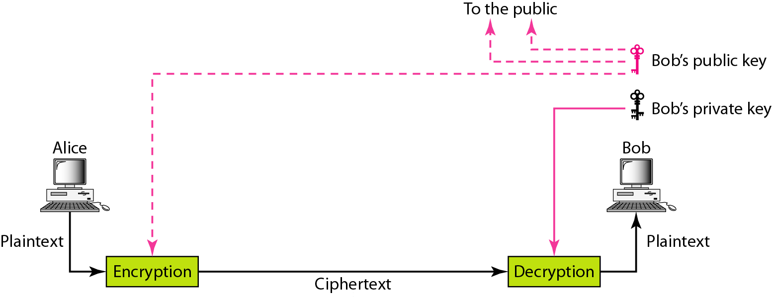
Figure 30.4 Asymmetric-key cryptography

Slide 4

Note
An asymmetric-key (or public-key) cipher uses two keys: one private (To encrypt data) and one public(To decrypt data).

Slide 5
Asymmetric Encryption Types
Two most popular algorithms are RSA & El Gamal
RSA
Developed by Ron Rivest, Adi Shamir, Len Adelman
Both public and private key are interchangable
Variable Key Size (512, 1024, or 2048 buts)
Most popular public key algorithm
El Gamal
Developed by Taher ElGamal
Variable key size (512 or 1024 bits)
Less common than RSA, used in protocols like PGP
Notes:
1. Must have done this as an assignment last year.

Slide 6
Asymmetric Encryption RSA
Choose two large prime numbers p & q
Compute n=pq and z=(p-1)(q-1)
Choose number e, less than n, which has no common factor (other than 1) with z
Find number d, such that ed – 1 is exactly divisible by z
Keys are generated using n, d, e
Public key is (n,e)
Private key is (n, d)
Encryption: c = m^{e} mod n
m is plain text
c is cipher text
Decryption: m = c^{d} mod n
Public key is shared and the private key is hidden
Notes:
1. Must have done this as an assignment last year.

Slide 7
Asymmetric Encryption RSA
P=5 & q=7
n=5*7=35 and z=(4)*(6) = 24
e = 5
d = 29 , (29x5 –1) is exactly divisible by 24
Keys generated are
Public key: (35,5)
Private key is (35, 29)
Encrypt the word love using (c = m^{e} mod n)
Assume that the alphabets are between 1 & 26
Plain Text | Numeric Representation | m^{e} | Cipher Text (c = m^{e} mod n)
l | 12 | 248832 | 17
o | 15 | 759375 | 15
v | 22 | 5153632 | 22
e | 5 | 3125 | 10
Notes:
1. Must have done this as an assignment last year.

Slide 8
Asymmetric Encryption RSA
Decrypt the word love using (m = c^{d} mod n)
n = 35, c=29
Cipher Text | c^{d} | (m = m^{e} mod n) | Plain Text
17 | 481968572106750915091411825223072000 | 17 | l
15 | 12783403948858939111232757568359400 | 15 | o
22 | 852643319086537701956194499721110000000 | 22 | v
10 | 100000000000000000000000000000 | 10 | e
Notes:
1. Must have done this as an assignment last year.

Slide 9
Asymmetric Encryption Weaknesses
Efficiency is lower than Symmetric Algorithms
A 1024-bit asymmetric key is equivalent to 128-bit symmetric key
Potential for man-in-the middle attack
It is problematic to get the key pair generated for the encryption
Notes:
1. Must have done this as an assignment last year.

Slide 10

Asymmetric Encryption Man-in-the-middle Attack
Hacker could generate a key pair, give the public key away and tell everybody, that it belongs to somebody else. Now, everyone believing it will use this key for encryption, resulting in the hacker being able to read the messages. If he encrypts the messages again with the public key of the real recipient, he will not be recognized easily.
Bob
Trudeau’s
Message
+ public key
Cipher
Trudeau’s
Encrypted
Message
David’s
Public Key
Bob’s
Message
+ Public key
Cipher
David’s
Public Key
Bob’s
Encrypted
Message
Trudeau
(Middle-man)
David
Bob’s
Public Key
Attacker
Trudeau’s
Public Key
Trudeau’s
Encrypted
Message
Cipher
Trudeau’s
New Message
+ public key
Trudeau’s
Encrypted
Message
Cipher
David’s
Message
+ public key
Notes:
1. Must have done this as an assignment last year.

Slide 11
Asymmetric Encryption Session-Key Encryption
Used to improve efficiency
Symmetric key is used for encrypting data
Asymmetric key is used for encrypting the symmetric key
Plain Text
Cipher
(DES)
Cipher Text
Send to Recipient
Cipher
(RSA)
Encrypted
Key
Session Key
Recipient’s Public Key
Notes:
1. Must have done this as an assignment last year.

Slide 12
Asymmetric Encryption Encryption Protocols
Pretty Good Privacy (PGP)
Used to encrypt e-mail using session key encryption
Combines RSA, TripleDES, and other algorithms
Secure/Multipurpose Internet Mail Extension (S/MIME)
Newer algorithm for securing e-mail
Backed by Microsoft, RSA, AOL
Secure Socket Layer(SSL) and Transport Layer Socket(TLS)
Used for securing TCP/IP Traffic
Mainly designed for web use
Can be used for any kind of internet traffic
Notes:
1. Must have done this as an assignment last year.

Slide 13

Asymmetric Encryption Key Agreement
Key agreement is a method to create secret key by exchanging only public keys.
Example
Bob sends Alice his public key
Alice sends Bob her public key
Bob uses Alice’s public key and his private key to generate a session key
Alice uses Bob’s public key and her private key to generate a session key
Using a key agreement algorithm both will generate same key
Bob and Alice do not need to transfer any key
Alice’s
Private Key
Cipher
(DES)
Bob’s
Public Key
Alice and Bob
Generate Same
Session Key!
Bob’s
Private Key
Session Key
Cipher
(DES)
Alice’s
Public Key
Notes:
1. Must have done this as an assignment last year.

Slide 14
Asymmetric Encryption Key Diffie-Hellman Mathematical Analysis
Bob & Alice
agree on non-secret
prime p and value a
Bob
Alice
Generate Secret
Random Number x
Generate Secret
Random Number y
Compute Public Key
a^{x} mod p
Bob & Alice exchange public keys
Compute Public Key
a^{y} mod p
Compute Session Key
(a^{y})^{x} mod p
Compute Session Key
(a^{x})^{y} mod p
Identical Secret Key

Slide 15
Asymmetric Encryption Key Agreement con’t.
Diffie-Hellman is the first key agreement algorithm
Invented by Whitfield Diffie & Martin Hellman
Provided ability for messages to be exchanged securely without having to have shared some secret information previously
Inception of public key cryptography which allowed keys to be exchanged in the open
No exchange of secret keys
Man-in-the middle attack avoided
Notes:
1. Must have done this as an assignment last year.

Slide 16
Cryptanalysis Basics
Practice of analyzing and breaking cryptography
Resistance to crypt analysis is directly proportional to the key size
With each extra byte strength of key doubles
Cracking Pseudo Random Number Generators
A lot of the encryption algorithms use PRNGs to generate keys which can also be cracked leading to cracking of algorithms
Variety of methods for safe guarding keys (Key Management)
Encryption & computer access protection
Smart Cards
Notes:
A web browser has a digital certificate from verisign which is the root certification authority.

Slide 17
Asymmetric Key Cryptography (Public Key Cryptography)
2 different keys are used
Users get the Key from an Certificate Authority
Advantages
More Secured
Authentication
Disadvantages
Relatively Complex

Slide 18
Thank You

